Slide 1
視窗程式設計 Homework 6-1 Window Program Design Homework 6-1
史蒂夫的煩惱

Slide 2

作業說明
Minecraft於2011年發佈正式版1.0.0
主角蒂帝夫在遊戲中身經百戰
轉眼間就已經過去13年了
而且最近還兼差拍電影
然而最近史蒂夫拍電影拍累了
想要回到2D賣塊的世界休息
請建造一個2D的賣塊世界給他養老

Slide 3
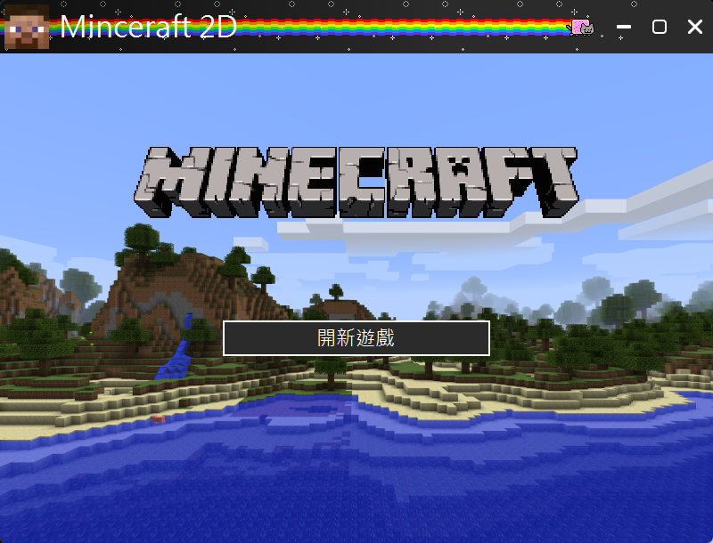
作業說明
開始畫面
開新遊戲按鈕打開新遊戲
其他自由發揮

Slide 4
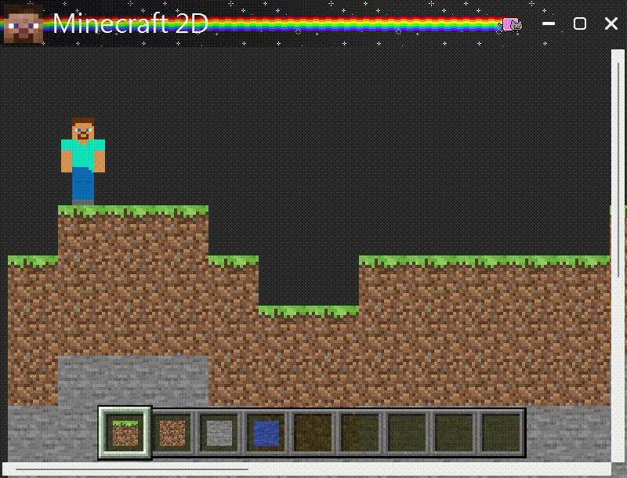
作業說明
遊戲畫面
生成30x15的地圖，地形不拘， 可以生成平地即可，但至少要 包含兩種方塊 (提示: 可將方塊直接放入Panel)
新增HScrollBar以及VScrollBar 移動視野 (提示: 如將方塊放進 Panel，可直接移動Panel即可)
加入史蒂夫到遊戲中 (站在其中一個方塊上即可)

Slide 5

作業說明
方塊選擇
底下快捷欄至少可選兩種方塊 樣式不拘，只要看得出來 目前使用的方塊
左鍵可以破壞方塊， 右鍵可以放置方塊， 所有方塊都需要一起移動 (提示: 可以把方塊放在同一個 Panel中，寫起來會比較快樂)

Slide 6
6-2

Slide 7
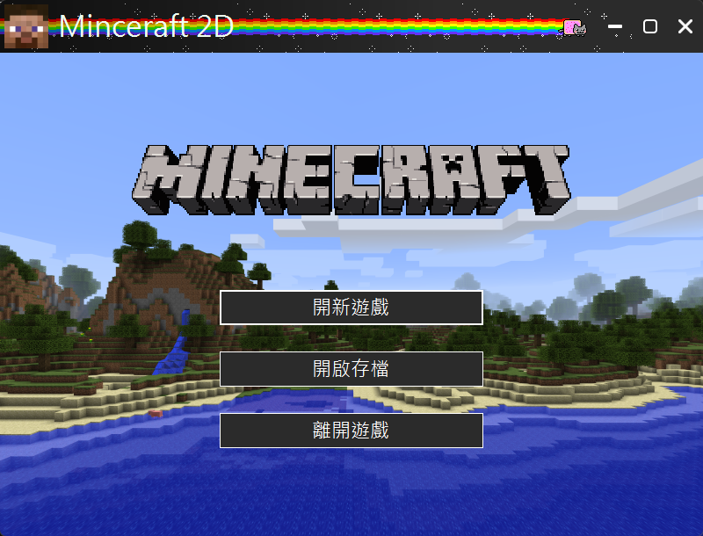
作業說明
開始畫面
新增開啟存檔功能
新增離開遊戲按鈕
其他自由發揮

Slide 8

作業說明
存檔功能
遊戲中按Escape鍵會暫停遊戲 並開啟遊戲選單， 包含回到遊戲、回到主畫面、 儲存並回到主畫面
按下儲存並回到主畫面後 將地圖儲存為檔案，格式不拘
開啟存檔時需要讀取地圖資料 並顯示
UI 形式不拘

Slide 9
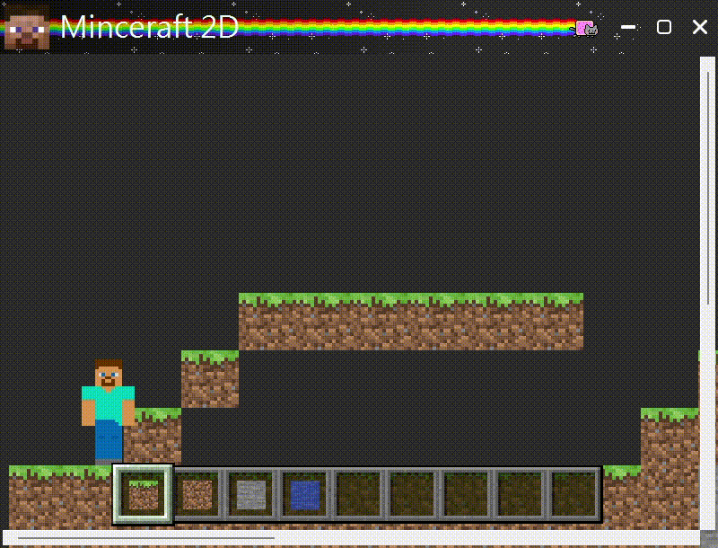
作業說明
史蒂夫移動(可做可不做)
使用wasd或是方向鍵 移動史蒂夫
需要有地心引力 在空中時要往下掉
按空白鍵可以跳躍
需要和地形碰撞

Slide 10
素材

Slide 11
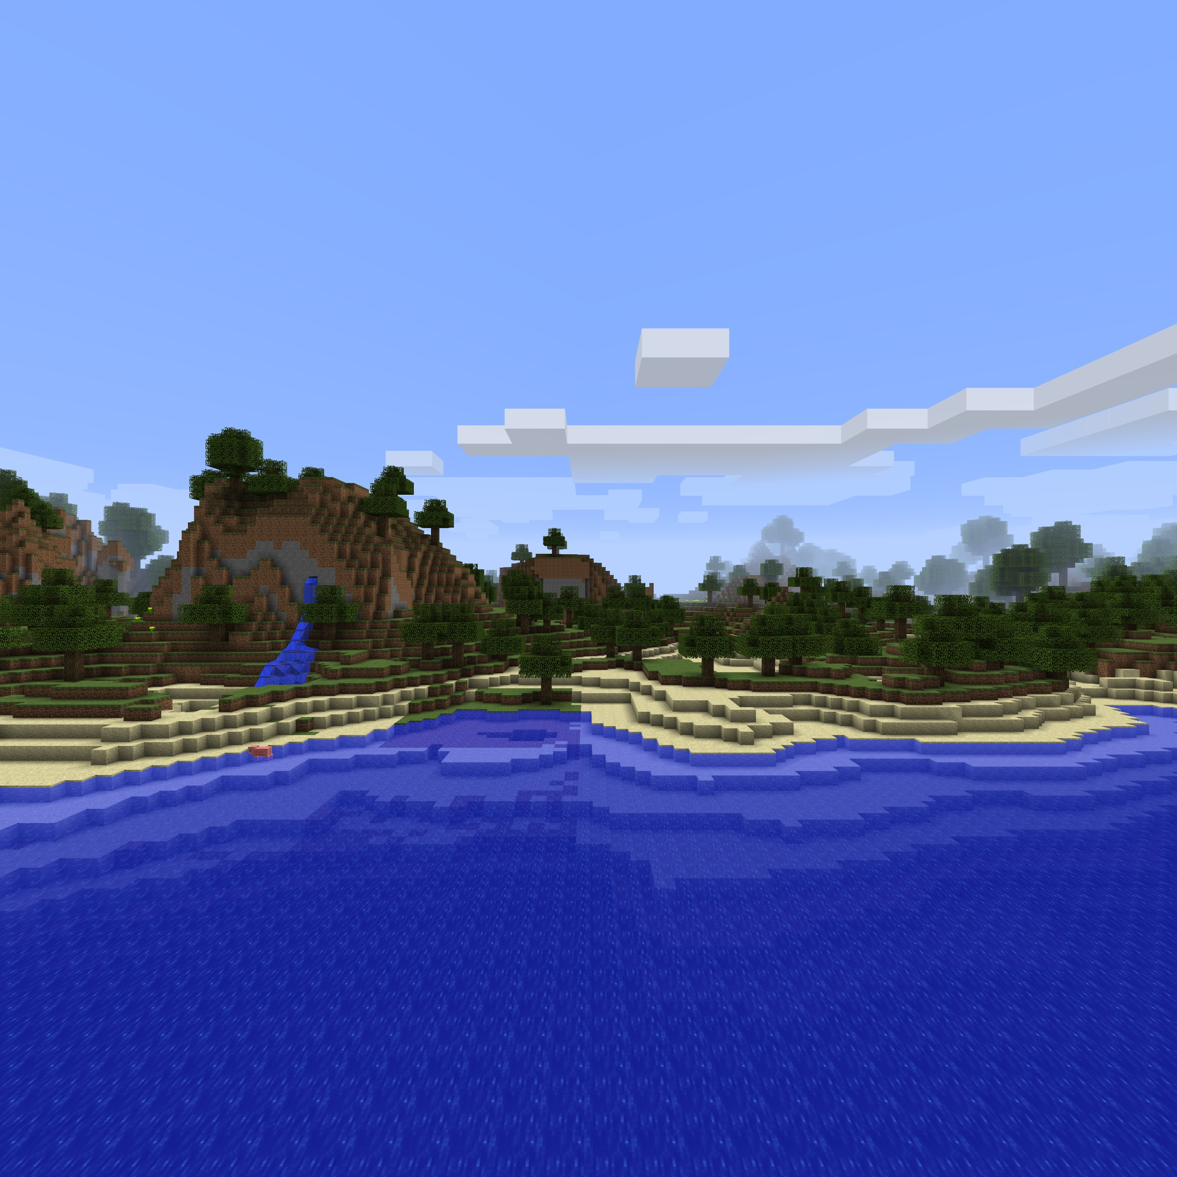
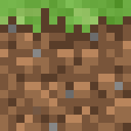
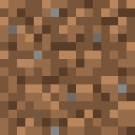
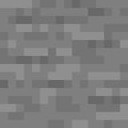




開啟ppt編輯模式，右鍵 另存成圖片

Slide 12
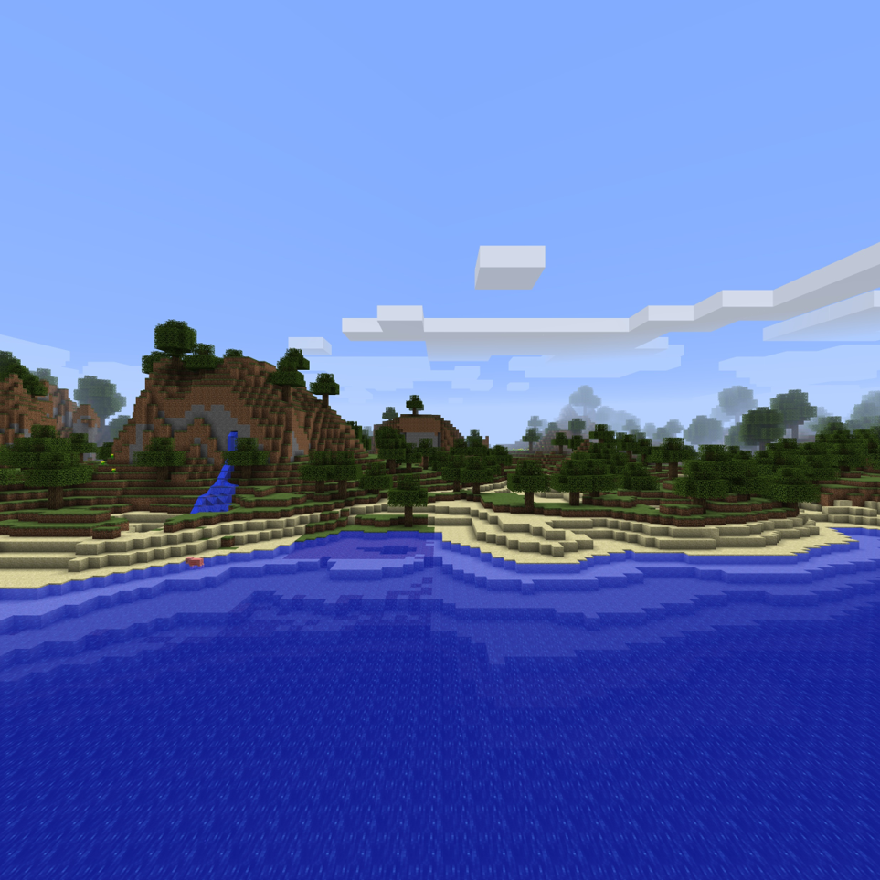

Slide 13
public class Block { public readonly Vector2F Position; public readonly BlockType Type; public PictureBox Picture; public enum BlockType { WATER, GRASS_BLOCK, DIRT, STONE, } public Block(Vector2F position, BlockType type) { Position = position; Type = type; } }
友情提供範例
注意，內有暗藏bug請勿直接使用
using System; namespace Practice6_1.lib; public class Vector2F { float _x, _y; public float X { get => _x; set => _x = value; } public float Y { get => _y; set => _y = value; } public Vector2F(float x, float y) { _x = x; _y = y; } public Vector2F() { _x = _y = 0; } public static Vector2F operator *(Vector2F a, float b) => new(a._x * b, a._y * b); public static Vector2F operator /(Vector2F a, float b) => new(a._x / b, a._y / b); public static Vector2F operator +(Vector2F a, Vector2F b) => new(a._x + b._x, a._y + b._y); public static Vector2F operator -(Vector2F a, Vector2F b) => new(a._x - b._x, a._y - b._y); public float length() => (float)Math.Sqrt(_x * _x + _y * _y); public override string ToString() { return $"({_x:F4}, {_y:F4})"; } }
public partial class Game : FormHelper { private const int padding = 10; private const int widthCount = 15; private const int heightCount = 15; private const int size = 64; private const int invBarPadding = 3; private Panel _panel; private Block[,] _blocks = new Block[heightCount, widthCount]; private BlockType?[] _invBarItem = new BlockType?[9]; private int _invBarItemIndex; private CustomImage _player; private readonly KeyRegister _keyReg; private readonly Stopwatch _stopwatch; private float _lastUpdateTime; public Game() { InitializeComponent(); _keyReg = new KeyRegister(this); _panel = new Panel(); _panel.Width = widthCount * size; _panel.Height = heightCount * size; _panel.Location = new Point(padding, padding); _panel.MouseClick += OnMouseClick; Controls.Add(_panel); Game_SizeChanged(this, null); _player = new CustomImage(); _player.Location = new Point(padding, padding); _player.Image = Resources.Steve; _player.SizeMode = PictureBoxSizeMode.Zoom; _player.Height = 112; _player.Width = 64; _panel.Controls.Add(_player); _playerPosition = new Vector2F(1, 12); UpdatePlayerPosition(); _stopwatch = new Stopwatch(); _stopwatch.Start(); for (int x = 0; x < widthCount; x++) { float n = GetNoise1D(x / 3f); int stoneLayer = (int)(n * 3) + 6; int grassBlockLayer = stoneLayer + 10; for (int y = 0; y < heightCount; y++) { if (y <= stoneLayer) { _blocks[y, x] = new Block(new Vector2F(x, y), BlockType.STONE); } else if (y <= grassBlockLayer) { if (y == grassBlockLayer) _blocks[y, x] = new Block(new Vector2F(x, y), BlockType.GRASS_BLOCK); else _blocks[y, x] = new Block(new Vector2F(x, y), BlockType.DIRT); } } } for (int y = 0; y < heightCount; y++) { for (int x = 0; x < widthCount; x++) { Block block = _blocks[y, x]; if (block == null) continue; CreateBlockPicture(x, y, block); } } _invBarItem[0] = BlockType.GRASS_BLOCK; _invBarItem[1] = BlockType.DIRT; _invBarItem[2] = BlockType.STONE; _invBarItem[3] = BlockType.WATER; UpdateInvBar(); } private static Image BlockTypeToImage(BlockType blockType) => blockType switch { BlockType.GRASS_BLOCK => Resources.Grass_Block, BlockType.DIRT => Resources.Dirt, BlockType.STONE => Resources.Stone, BlockType.WATER => Resources.Water, _ => throw new ArgumentOutOfRangeException(nameof(blockType), blockType, null) }; private void UpdateInvBar() { for (int i = 0; i < 9; i++) { if (_invBarItem[i] == null) continue; CustomImage item = new CustomImage(); item.Image = BlockTypeToImage((BlockType)_invBarItem[i]); item.Size = new Size(32, 32); int w = (InventoryBar.Width - invBarPadding * 2) / 9; item.Location = new Point( invBarPadding + w * i + (w - item.Width) / 2, (InventoryBar.Height - item.Height) / 2); InventoryBar.Controls.Add(item); } } private void UpdateInvBarIndex() { int w = (InventoryBar.Width - invBarPadding * 2) / 9; InventoryBarSelect.Location = new Point(InventoryBar.Left - 3 + w * _invBarItemIndex, InventoryBar.Top - 3); } private void CreateBlockPicture(int x, int y, Block block) { int yVal = heightCount - y - 1; PictureBox box = block.Picture = new PictureBox(); box.Size = new Size(size, size); box.SizeMode = PictureBoxSizeMode.Zoom; box.Image = block.Type switch { BlockType.GRASS_BLOCK => Resources.Grass_Block, BlockType.DIRT => Resources.Dirt, BlockType.STONE => Resources.Stone, BlockType.WATER => Resources.Water, _ => null }; box.Visible = true; box.Enabled = false; box.Top = yVal * size; box.Left = x * size; _panel.Controls.Add(box); } private void SetBlock(int x, int y, BlockType blockType) { if (_blocks[y, x] != null) RemoveBlock(x, y); Block block = _blocks[y, x] = new Block(new Vector2F(x, y), blockType); CreateBlockPicture(x, y, block); } private void RemoveBlock(int x, int y) { Block block = _blocks[y, x]; if(block == null) return; _blocks[y, x] = null; if (block.Picture == null) return; _panel.Controls.Remove(block.Picture); } private void OnMouseClick(object sender, MouseEventArgs e) { int x = e.X / size; int y = (_panel.Height - e.Y) / size; if (e.Button == MouseButtons.Right && _blocks[y, x] == null && _invBarItem[_invBarItemIndex] != null) { SetBlock(x, y, (BlockType)_invBarItem[_invBarItemIndex]); } if (e.Button == MouseButtons.Left) { RemoveBlock(x, y); } } private void GameUpdate(object sender, ElapsedEventArgs e) { // Get the current time in seconds float currentTime = (float)_stopwatch.Elapsed.TotalSeconds; float deltaTime = currentTime - _lastUpdateTime; _lastUpdateTime = currentTime; for (int i = 1; i < 10; i++) { if (_keyReg.Key[i] && i != _invBarItemIndex + 1) { _invBarItemIndex = i - 1; UpdateInvBarIndex(); } } } private void UpdatePlayerPosition() { _player.Location = new Point( (int)(_playerPosition.X * size), (int)(_panel.Height - _playerPosition.Y * size - _player.Height) ); } private static float GetNoise1D(float x) { return (float)(Math.Sin(2 * x) + Math.Sin(Math.PI * x)) / 4 + 0.5f; } private float GetScrollPercent(ScrollBar scrollBar) { float scrollPos; if (scrollBar.Maximum == scrollBar.LargeChange) scrollPos = scrollBar.Value; else scrollPos = (float)scrollBar.Value / (scrollBar.Maximum - scrollBar.LargeChange); if (scrollPos > 1) scrollPos = 1; return scrollPos; } private void Game_SizeChanged(object sender, EventArgs e) { hScrollBar.Maximum = (int)((float)(_panel.Width + padding * 2) / Width * hScrollBar.LargeChange); vScrollBar.Maximum = (int)((float)(_panel.Height + padding * 2) / Height * vScrollBar.LargeChange); hScrollBar_Scroll(this, null); vScrollBar_Scroll(this, null); } private void hScrollBar_Scroll(object sender, ScrollEventArgs e) { int len = _panel.Width + padding * 2 - Width; if (len < 0) { _panel.Left = padding; return; } _panel.Left = (int)(-len * GetScrollPercent(hScrollBar) + padding); } private void vScrollBar_Scroll(object sender, ScrollEventArgs e) { int len = _panel.Height + padding * 2 - Height; if (len < 0) { _panel.Top = padding; return; } _panel.Top = (int)(-len * GetScrollPercent(vScrollBar) + padding); } }

Slide 14
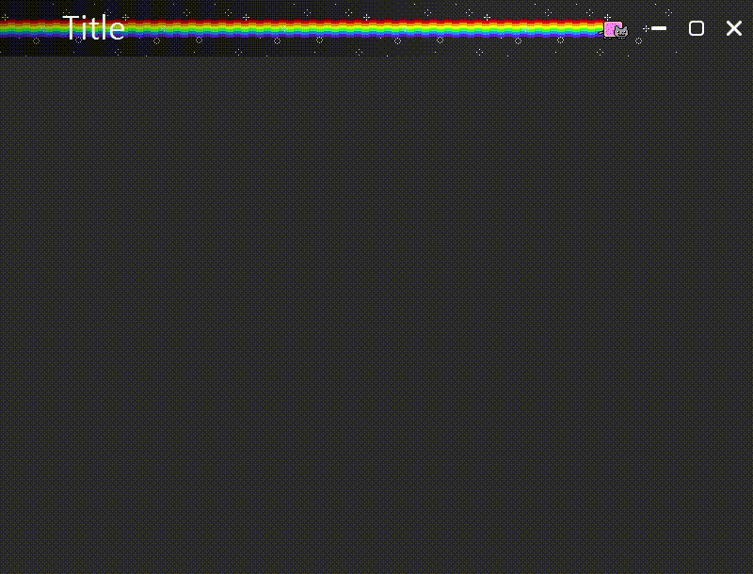
Hello habibi Rainbow cat custom window made of alumulemu floor to ceiling window if you like, cut cut me

